Slide 1
COMP 2710 Software Construction
Operator Overloading and Friends
Dr. Alvin Lim
Auburn University
http://www.eng.auburn.edu/~lim
limalvi@auburn.edu
Fall 2014
These slides are adapted from notes by Dr. Walter Savitch (UCSD)

Slide 2
Overloading Unary Operators
C++ has unary operators:
  Defined as taking one operand
  e.g., - (negation)
    x = -y; // Sets x equal to negative of y
  Other unary operators:
    ++, --
Unary operators can also be overloaded
Copyright © 2008 Pearson Addison-Wesley. All rights reserved.
8-<number>

Slide 3
Overload "-" for Money
Overloaded "-" function declaration
  Placed outside class definition:
  const Money operator –(const Money& amount);
  Notice: only one argument
    Since only 1 operand (unary)
"-" operator is overloaded twice!
  For two operands/arguments (binary)
  For one operand/argument (unary)
  Definitions must exist for both
Copyright © 2008 Pearson Addison-Wesley. All rights reserved.
8-<number>

Slide 4
class Money
{
public:
Money( );
Money(double amount);
Money(int theDollars, int theCents);
Money(int theDollars);
double getAmount( ) const;
int getDollars( ) const;
int getCents( ) const;
void input( ); //Reads the dollar sign as well as the amount number.
void output( ) const;
private:
int dollars; //A negative amount is represented as negative dollars and
int cents; //negative cents. Negative $4.50 is represented as -4 and -50
int dollarsPart(double amount) const;
int centsPart(double amount) const;
int round(double number) const;
};
Copyright © 2008 Pearson Addison-Wesley. All rights reserved.
8-<number>

Slide 5
Overloaded "-" Definition
Why use “const” here?
Overloaded "-" function definition:
const Money operator –(const Money& amount)
{
return Money(-amount.getDollars(),
-amount.getCents());
}
Applies "-" unary operator to built-in type
  Operation is "known" for built-in types
Returns anonymous object again
Copyright © 2008 Pearson Addison-Wesley. All rights reserved.
8-<number>

Slide 6
Overloaded "-" Usage
Consider:
Money amount1(10),
amount2(6),
amount3;
amount3 = amount1 – amount2;
    Calls binary "-" overload
amount3.output(); //Displays $4.00
amount3 = -amount1;
    Calls unary "-" overload
amount3.output() //Displays -$10.00
Copyright © 2008 Pearson Addison-Wesley. All rights reserved.
8-<number>

Slide 7
Overloading Basics
Overloading operators
  VERY similar to overloading functions
  Operator itself is "name" of function
Example Declaration:
const Money operator +(const Money& amount1,
const Money& amount2);
  Overloads + for operands of type Money
  Uses constant reference parameters for efficiency
  Returned value is type Money
    Allows addition of "Money" objects
Copyright © 2008 Pearson Addison-Wesley. All rights reserved.
8-<number>

Slide 8
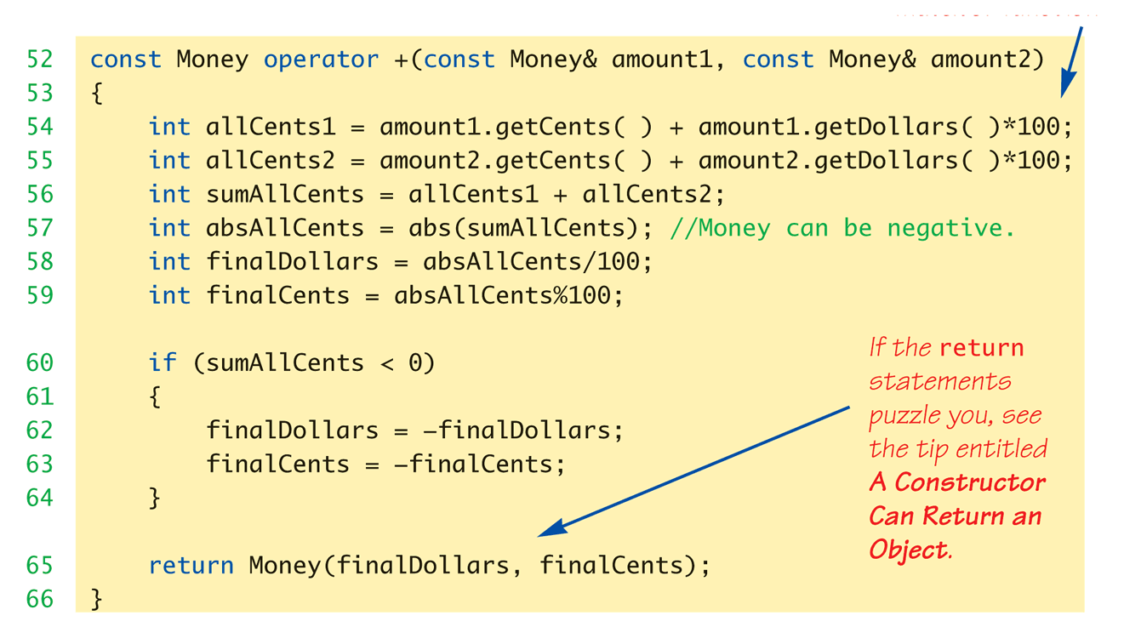
Money "+" Definition:
Display 8.1 Operator Overloading
Definition of "+" operator for Money class:
Copyright © 2008 Pearson Addison-Wesley. All rights reserved.
8-<number>

Slide 9
Overloading as Member Functions
Previous examples: standalone functions
  Defined outside a class
Can overload as "member operator"
  Considered "member function" like others
When operator is member function:
  Only ONE parameter, not two!
  Calling object serves as 1st parameter
Copyright © 2008 Pearson Addison-Wesley. All rights reserved.
8-<number>

Slide 10
Member Operator in Action
Money cost(1, 50), tax(0, 15), total;
total = cost + tax;
  If "+" overloaded as member operator:
    Variable/object cost is calling object
    Object tax is single argument
  Think of as: total = cost.+(tax);
Declaration of "+" in class definition:
  const Money operator +(const Money& amount);
  Notice only ONE argument
Copyright © 2008 Pearson Addison-Wesley. All rights reserved.
8-<number>

Slide 11
const Functions
When to make function const?
  Constant functions not allowed to alter class
  member data
  Constant objects can ONLY call constant
  member functions
Good style dictates:
  Any member function that will NOT modify data
  should be made const
Use keyword const after function
declaration and heading
Copyright © 2008 Pearson Addison-Wesley. All rights reserved.
8-<number>

Slide 12
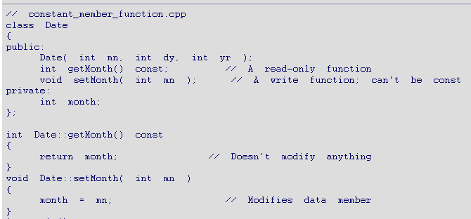
const Functions – An Example
8-<number>

Slide 13
Overloading Operators:
Which Method?
Object-Oriented-Programming
  Principles suggest member operators
  Many agree, to maintain "spirit" of OOP
Member operators more efficient
  No need to call accessor &
  mutator functions
At least one significant disadvantage
  (Later in chapter…)
Copyright © 2008 Pearson Addison-Wesley. All rights reserved.
8-<number>

Slide 14
Overloading Function Application ()
Function call operator, ( )
  Must be overloaded as member function
  Allows use of class object like a function
  Can overload for all possible numbers
  of arguments
Example:
Aclass anObject;
anObject(42);
    If ( ) overloaded → calls overload
Copyright © 2008 Pearson Addison-Wesley. All rights reserved.
8-<number>

Slide 15
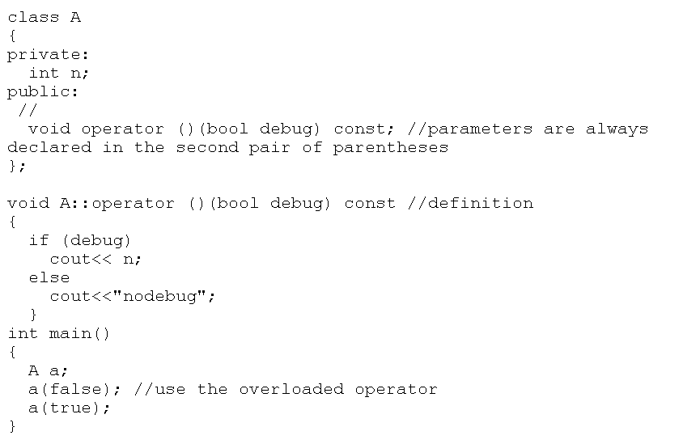
Overloading Function Application ()
8-<number>

Slide 16
Other Overloads
&&, ||, and comma operator
  Predefined versions work for bool types
  Recall: use "short-circuit evaluation"
  When overloaded no longer uses
  short-circuit
    Uses "complete evaluation" instead
    Contrary to expectations
Generally should not overload these operators
Copyright © 2008 Pearson Addison-Wesley. All rights reserved.
8-<number>

Slide 17
Friend Functions
Nonmember functions
  Recall: operator overloads as nonmembers
    They access data through accessor and mutator
    functions
    Very inefficient (overhead of calls)
Friends can directly access private class data
  No overhead, more efficient
So: best to make nonmember operator
overloads friends!
Copyright © 2008 Pearson Addison-Wesley. All rights reserved.
8-<number>

Slide 18
Friend Functions
Friend function of a class
  Not a member function
  Has direct access to private members
    Just as member functions do
Use keyword friend in front of
function declaration
  Specified IN class definition
  But they’re NOT member functions!
Copyright © 2008 Pearson Addison-Wesley. All rights reserved.
8-<number>

Slide 19
Friend Functions Example
class Money
{
public:
Money( );
Money(double amount);
Money(int dollars, int cents);
Money(int dollars);
double getAmount( ) const;
int getDollars( ) const;
int getCents( ) const;
void input( ); //Reads the dollar sign as well as the amount number.
void output( ) const;
friend const Money operator +(const Money& amount1, const Money& amount2);
friend const Money operator -(const Money& amount1, const Money& amount2);
friend bool operator ==(const Money& amount1, const Money& amount2);
friend const Money operator -(const Money& amount);
private:
int dollars; //A negative amount is represented as negative dollars and
int cents; //negative cents. Negative $4.50 is represented as -4 and -50
int dollarsPart(double amount) const;
int centsPart(double amount) const;
int round(double number) const;
};
Copyright © 2008 Pearson Addison-Wesley. All rights reserved.
8-<number>

Slide 20
Friend Functions Example
const Money operator +(const Money& amount1, const Money& amount2)
{
int allCents1 = amount1.cents + amount1.dollars*100;
int allCents2 = amount2.cents + amount2.dollars*100;
int sumAllCents = allCents1 + allCents2;
int absAllCents = abs(sumAllCents); //Money can be negative.
int finalDollars = absAllCents/100;
int finalCents = absAllCents%100;
if (sumAllCents < 0)
{
finalDollars = -finalDollars;
finalCents = -finalCents;
}
return Money(finalDollars, finalCents);
}
Note that friends have direct access to
Member variables
Copyright © 2008 Pearson Addison-Wesley. All rights reserved.
8-<number>

Slide 21
Friend Function Uses
Operator Overloads
  Most common use of friends
  Improves efficiency
  Avoids need to call accessor/mutator
  member functions
  Operator must have access anyway
    Might as well give full access as friend
Friends can be any function
Copyright © 2008 Pearson Addison-Wesley. All rights reserved.
8-<number>

Slide 22
Friend Function Purity
Friends not pure?
  "Spirit" of OOP dictates all operators and functions be member functions
  Many believe friends violate basic OOP principles
Advantageous?
  For operators: very!
  Allows automatic type conversion
  Still encapsulates: friend is in class definition
  Improves efficiency
Copyright © 2008 Pearson Addison-Wesley. All rights reserved.
8-<number>

Slide 23
Friend Classes
Entire classes can be friends
  Similar to function being friend to class
  Example:
  class F is friend of class C
    All class F member functions are friends of C
    NOT reciprocated
    Friendship granted, not taken
Syntax: friend class F
  Goes inside class definition of "authorizing" class
See an example friends.cpp
Copyright © 2008 Pearson Addison-Wesley. All rights reserved.
8-<number>

Slide 24
Friend Classes
class F; // forward declaration
class C
{
public:
…….
    friend class F; // All class F member functions are friends of C
……..
};
class F
{
………
};
Copyright © 2008 Pearson Addison-Wesley. All rights reserved.
8-<number>

